Slide 1

Predicting customer churn at Syriatel
Presenter: Tai Bui

Slide 2

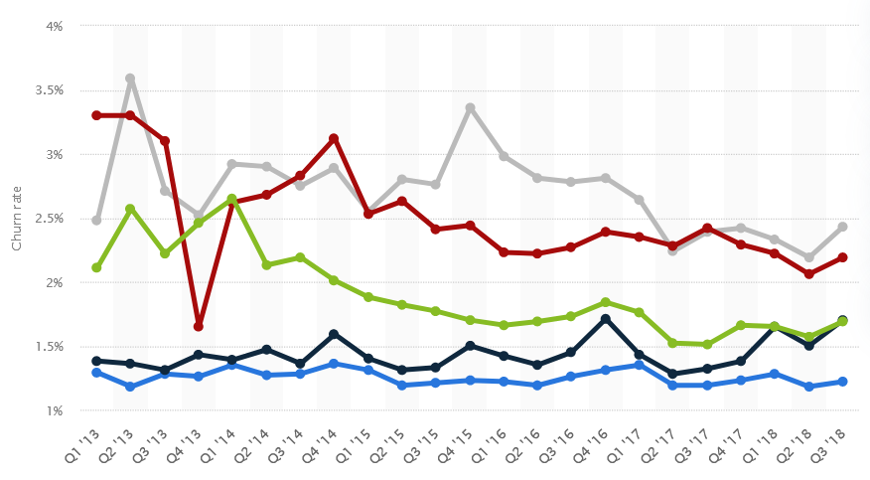
BUSINESS OVERVIEW
Average monthly churn rate for wireless carriers in the United States from Q1, 2013 to Q3 2018
The average monthly churn rate for U.S. telecom companies: 1.9% for wireless carriers and around 1.6% for broadband services.
Costs U.S. telecom companies billions of dollars each year.
Common causes: pricing, customer service, network performance, etc.
Notes:
For instance, a company with 10 million customers and a 1.9% monthly churn rate would lose approximately 190,000 customers each month.

Slide 3


Project Objectives
o1.
Develop a predictive model to determine churn
o2.
Identify key factors influencing customer churn
o3.
Provide actionable insights to reduce churn

Slide 4

Data Overview
Dataset is provided by the Kaggle community
20 predictor variables, 3333 records
The ratio of churners in this dataset is 14%
Feature instances (customer usage patterns) such as account length, total day charge, customer service call, etc.

Slide 5
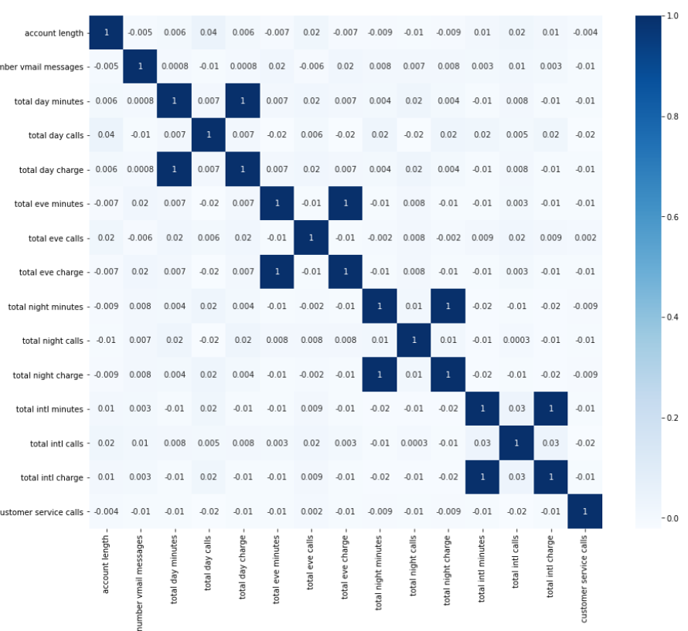
Preprocessing
Remove multicollinearity by dropping columns with perfect correlations

Slide 6
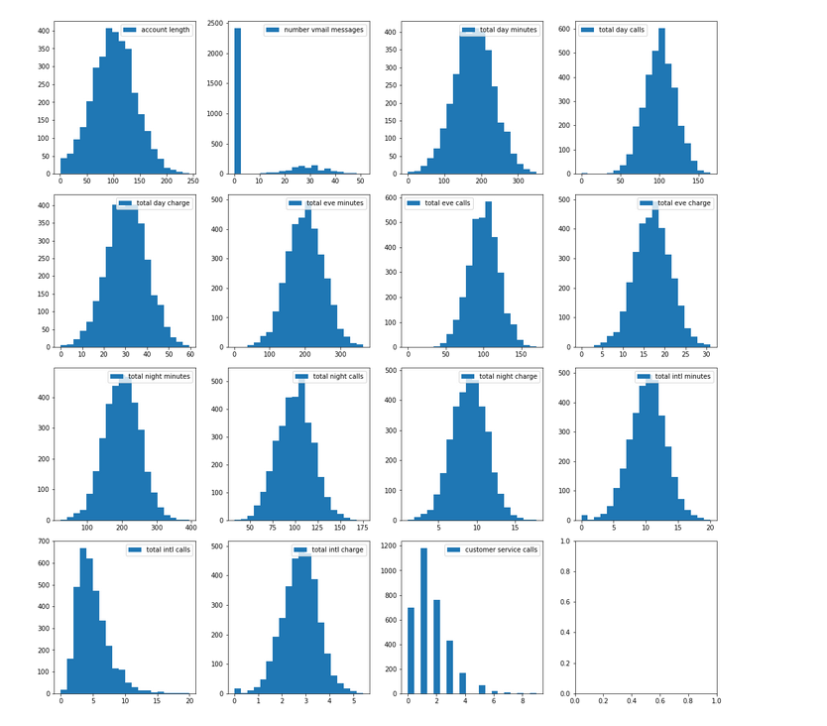
Preprocessing
Apply one-hot encoding for categorical features
Train – test split with test size set at 25%
Normalize both train and test separately with Standard Scaler for numerical features

Slide 7

Logistic Regression
Without any regularization, achieve
76.37% accuracy rate
66.4% recall rate
AUC ROC is 0.80.
Tuning this with different regularization does not improve model

Slide 8
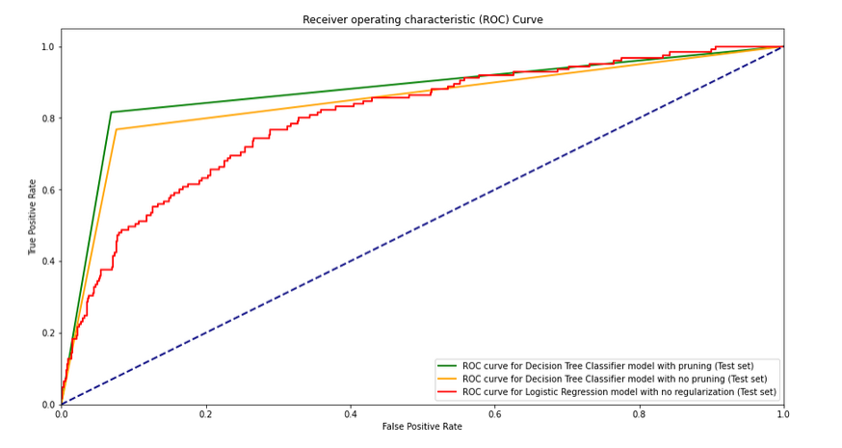
Decision Tree classification
Final model with maximum depth set at 5
91.36% accuracy
81.6% recall rate
AUC ROC 0.8734

Slide 9
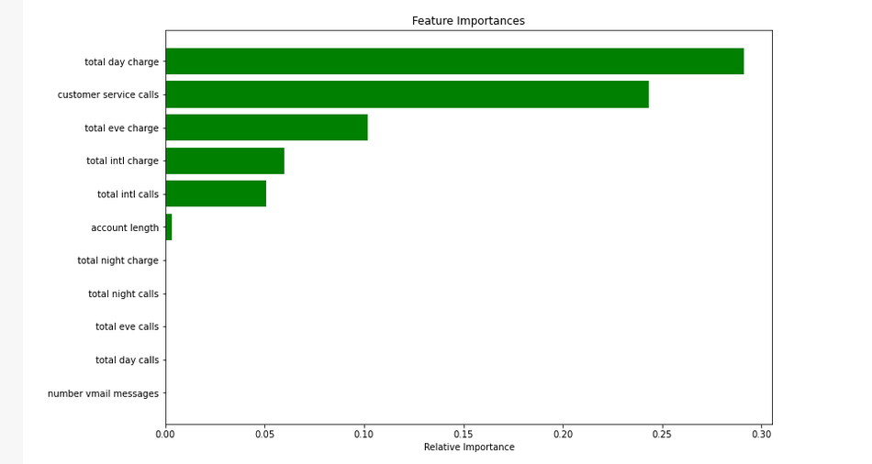
REcommendations
Reduce charges for day and evening calls with campaigns or customer loyalty programs
Improve customer service by reducing waiting times and providing extensive training

Slide 10

Thank you
Please send all questions to:
taingocbui@gmail.com
Contact:
https://www.linkedin.com/in/tai-bui-ngoc/

